Slide 1

AI Chatbot in Java: Bridging the Gap Between Humans and Machines
INNOVATORS
Group Members:
Roll no. Name
Soham Wagale
113 Vinay Mante
Vaishnavi Shinde
Harshada Jadhav

Slide 2
Introduction: The Rise of Conversational AI and Our Project's Vision
AI Chatbots Today
AI chatbots have transformed customer service, personal assistance, and information retrieval, radically enhancing user engagement across industries.
Why Java?
Leveraging Java's robustness and portability ensures that our chatbot is flexible and easy to integrate, opening doors for future scalability and platform independence.
Project Vision
This project demonstrates a simple desktop-based AI chatbot built in Java, utilizing a local Ollama server hosting the llama3.2 model. It features a clean graphical interface with real-time interaction and streaming response handling.

Slide 3
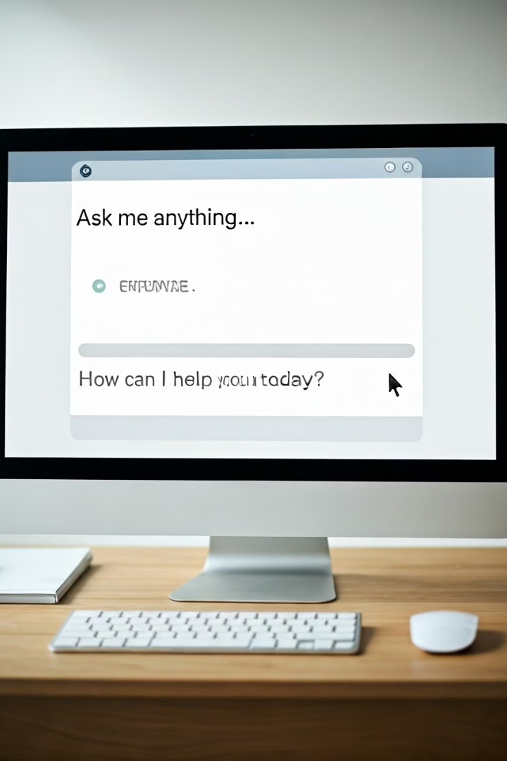
Objectives: Building an Intelligent and User-Friendly Chatbot
Natural Language Understanding
Easy Integration
Design flexible architecture for seamless embedding into various platforms.
Enable chatbot to comprehend, process, and respond accurately to queries.
Enhanced User Experience
Focus on responsiveness, clarity, and helpful conversations.

Slide 4
System Architecture: Components and Data Flow of Our AI Chatbot
Frontend (Java Swing):
Backend (Ollama):
Communication:
Handles UI components and user input/output display
Receives user prompts through HTTP POST, processes using a local LLM, and streams output.
Performed using Java's HttpClient with streamed JSON parsing for real-time interaction.

Slide 5





Chatbot in Action: Demo and Explanation of Conversational Flow
User Input
Receive text and tokenize for processing.
Intent Recognition
Classify user intent using pattern matching.
Response Generation
Select appropriate reply from predefined responses.
Output Delivery
Display message back to the user interface.

Slide 6




Core Java Concepts: Powering the Chatbot's Intelligence
Object-Oriented Programming
Data Structures
Encapsulates chatbot components like user interface and processing engine into reusable, modular classes
Uses arrays and Array Lists to store conversation templates and dynamic user data efficiently.
1
2
Control Flow Statements
4
3
Exception Handling
Implements decision-making
using if-else and switch
cases to determine chatbot responses.
Robust control improving chatbot stability error.

Slide 7

Thank You

